Slide 1
Object Detection and Model Comparison

Slide 2

HELLO!
Rakesh Bhavsar
Ayush Jaiswal
Dharamendra Kumar

Slide 3
INTRODUCTION
In this project, we are performing Object Detection by implementing Faster R-CNN & SSD using Keras Deep learning framework.
We are using Serverless architecture (AWS Lambda) for deep learning model evaluation.
Web UI where user uploads an image, than can see the result evaluated by AWS Lambda function.
Dataset: PASCAL VOC 2007, 2012,
COCO 2015
IMAGENET

Slide 4
PROPOSED METHOD

Slide 5
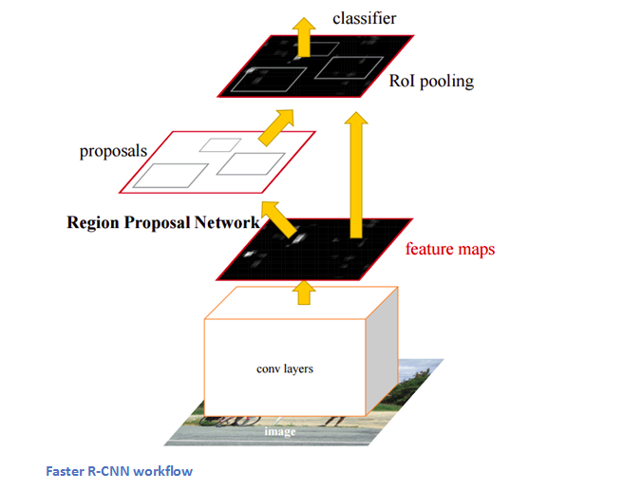
FASTER-RCNN
Insert a region proposal network (RPN) after the last convolutional layer.
This network is able to just look at the last convolutional feature map and produce region proposals from that.
From that stage, the same pipeline as R-CNN is used (ROI pooling, FC, and then classification and regression heads)
nn

Slide 6
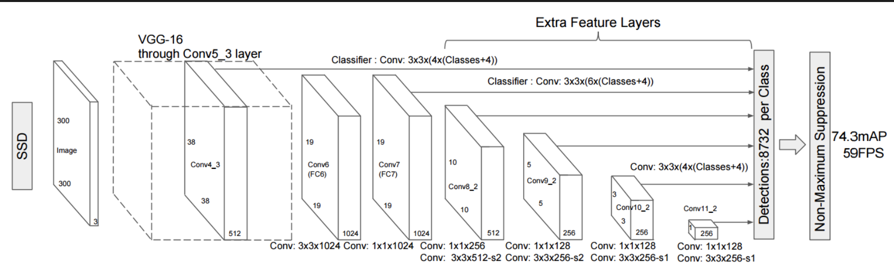
SSD
SSD discretizes the output space of bounding boxes into a set of default boxes over different aspect ratios and scales per feature map location.
At prediction time, the network generates scores for the presence of each object category in each default box and produces adjustments to the box to better match the object shape.
Additionally, the network combines predictions from multiple feature maps with different resolutions to naturally handle objects of various sizes.
SSD is much faster than Faster-RCNN

Slide 7
ARCHITECTURE

Slide 8
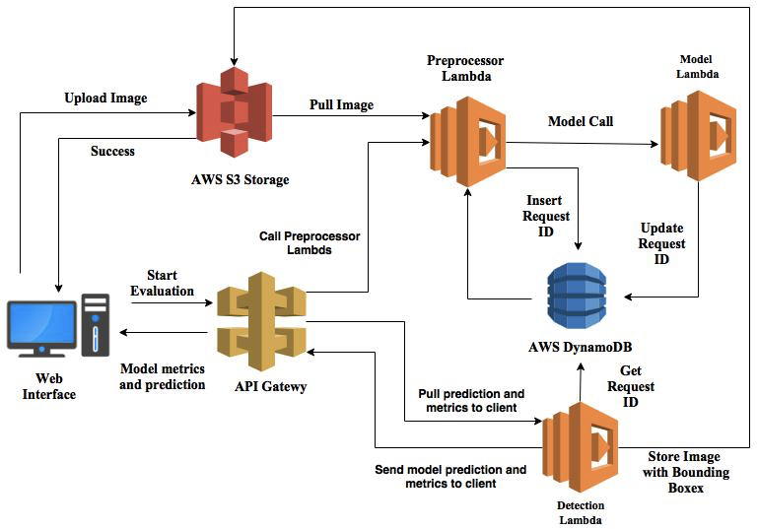

Slide 9
REFERENCES

Slide 10
REFERENCES
SSD: https://arxiv.org/pdf/1512.02325.pdf
FasterRCNN: https://arxiv.org/pdf/1506.01497.pdf
https://github.com/yhenon/keras-frcnn
https://github.com/rykov8/ssd_keras
https://aws.amazon.com/blogs/compute/seamlessly-scale-predictions-with-aws-lambda-and-mxnet/

Slide 11
THANKS!

